Slide 1
Mental Health eScreening
Primary Care Clinician Training
January 28, 2015

Slide 2
Introduction to the eScreening tablet system
Mental Health eScreening Research Pilot
For the last two years, members of the Center for Excellence in Stress and Mental Health (CESAMH) have been using eScreening for OEF/OIF/OND Veterans enrolling in VA Health Care in San Diego. CESAMH has also been tracking OOO Veterans for depression, suicide risk, PTSD, and more.
We (CESAMH) found that about half of the newly enrolled had risk factors for suicide, indicating the need for immediate clinical follow-up. Many of them had symptoms of depression or anxiety, and the majority of these younger Veterans were in physical pain.

Slide 3
Introduction to the eScreening tablet system
We have compared screening times between Veterans using paper packet forms versus Veterans using CESAMH tablets to self-assess during enrollment. We found that almost all of the tablet-using Veterans had their screenings documented an average of 19 days sooner than the Veterans who used paper packet forms.
This is a fantastic leap forward in patient care.
We have the cutting edge technology, but without you, we can’t make the process successful. We are asking you to work with us as we roll out a new, upgraded, tablet system with a faster and more user-friendly interface.

Slide 4
Introduction to the eScreening tablet system
Benefits of using eScreening
The New System
*It’s an upgraded tablet system with a faster and more user-friendly interface.
*We believe we can achieve the same positive results in other clinics while at the same time minimizing the workload that is already required of staff.
Findings from the Research Pilot
eScreening:
was preferred by both Clinicians and Veterans
increased access to mental and physical health screening
allowed for timely triage to appropriate services without increasing staff (approximately 40% of Vets need immediate follow-up with the Suicide Risk Assessment)
created significant improvement in many areas of clinical care
Has far-reaching implications for how technology can streamline screening for mental and physical health needs in healthcare systems.

Slide 5


Training Modules
Today’s Training Covers:
Overview 5 minutes
Setting Up an Assessment 4 minutes
Reporting and Data 1 minute
Troubleshooting & Additional Support 1 minute
User Roles, Permissions, & Security 2 minutes
Dashboard Features 6 minutes
1
2
3
4
5
6

Slide 6
1 | Overview
What is Mental Health eScreening (MHE)?
It’s an electronic assessment system that will replace the manual, paper-based process used for initial screening of Veterans in VA healthcare settings.
MHE enables Veterans to answer self-assessments on a tablet or PC while in a clinic.
MHE accelerates patient enrollment by allowing clinicians to oversee the patient-directed screening with real-time scoring, chart note generation, and if pre-determined parameters are exceeded, immediate crisis alerts.
Goals
Facilitate comprehensive mental health screening for newly enrolling Veterans nationwide.
Increase the number of Veterans receiving mental health services.
Improve patient engagement and satisfaction, without an increase in staff and resources.
Gather health data and share with clinicians to improve care delivery to Veterans.

Slide 7
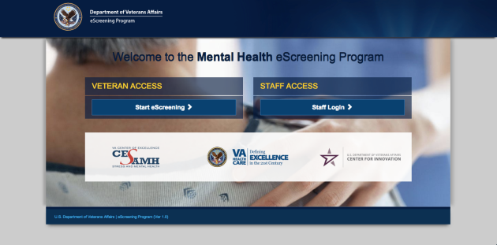
1 | Accessing the application
Access the MHE application with a tablet or a PC, by typing the web address into your browser’s URL field: http://vaww.escreening.va.gov/sd/
The address will be added to the Shared Drive.
The Welcome screen opens:

Slide 8
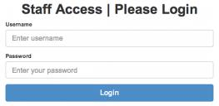

1 | Logging in
Click Staff Login >. The Staff Access | Please Login opens:
Type your user name and password, then click Login.
Your Home page opens:

Slide 9

1 | Logging out
Click Logout. The system logs you out.
Automatic logout
If you are inactive for 20 minutes, the system will warn that you have 20 seconds before an automatic logout. You must interact with the program if you want to keep your session open. If the system logs you out but you want to keep working, simply log in again.

Slide 10
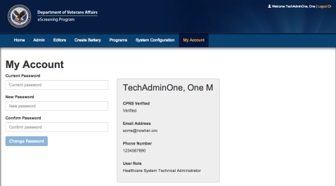
1 | Changing your password
From your Home page, click My Account. The My Account tab opens:
Type your current password.
Type and re-type your new password, then click Change Password. The system updates your password.

Slide 11
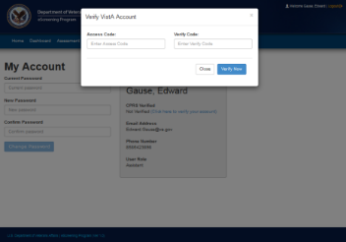
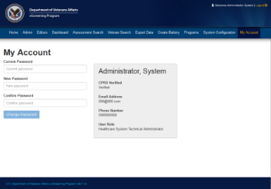

1 | Verifying your CPRS Account
The My Accounts page is also where you verify your CPRS account (one-time only).
Click Click here to verify your account.
Type your Access and Verify Codes.
Click Verify Now.
Log out, then log back in. Your account is verified.

Slide 12


Training Modules
Today’s Training Covers:
Overview 5 minutes
Setting Up an Assessment 4 minutes
Reporting and Data 1 minute
Troubleshooting & Additional Support 1 minute
User Roles, Permissions, & Security 2 minutes
Dashboard Features 6 minutes
1
2
3
4
5
6

Slide 13
2 | User roles and permissions
MHE System Roles
Consultation and Program Evaluation (done by CESAMH)
Healthcare System Technical Administrator
Clinician
Assistant
Veteran
Reporting and Metrics
Extracts clinical Battery data from the eScreening database for all sites, to:
identify trends and compare them for program and progress evaluation, and
provide feedback for improvement.
Technical Support
Edits and assigns users;
manages system level settings.
Creates, edits, deletes, & uploads Batteries.
Manages Battery errors.
Completes forms and follow-ups.
Patient Care
Receives clinical data from CPRS.
Utilizes the health data collected through the eScreening application.
Monitors the Battery dashboard with alerts
Medical Support
Creates Batteries for Veterans to complete in the waiting room.
Can access the dashboard to finalize assessment.
The Patient
Completes the Screening Battery.

Slide 14
2 | User Management - Security
Tablets will not function outside of the hospital grounds.
Tablets have built-in tracking capability.
The system records the name and address of the last Veteran who used a missing tablet.
Staff will not be held responsible for tablets which are stolen or broken by a Veteran.

Slide 15


Training Modules
Today’s Training Covers:
Overview 5 minutes
Setting Up an Assessment 4 minutes
Reporting and Data 1 minute
Troubleshooting & Additional Support 1 minute
User Roles, Permissions, & Security 2 minutes
Dashboard Features 6 minutes
1
2
3
4
5
6

Slide 16
3 | Setting up Assessments
Assessments may be created in a batch for the next day’s appointments, or they may be created singly for a walk-in Veteran.
Before a Veteran can begin eScreening, one of these users must set up an assessment for the Veteran:
Clinician (LVNs, RNs, NPs, MDs, etc.)
Assistant (MSA, etc.)
Setting up an assessment consists of these procedures done in sequence:
Searching by VistA clinic for pre-existing appointments and or Veterans.
B. Creating Assessments and assigning Due Clinical Reminders for the selected Veterans.
After A and B are complete, the system is ready to accept input on a tablet from the Veteran.

Slide 17
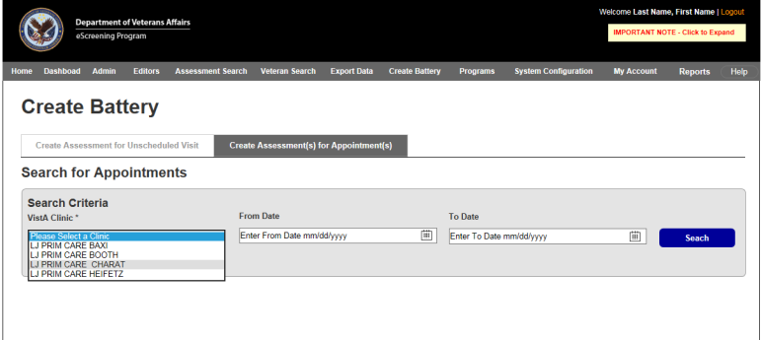



3 | Setting up Assessments
A. Searching for Appointments
From the Home screen, click the Create Battery tab.
Click Create Assessment(s) for Appointments.
Select the Search criteria for the Clinic and Date Range.
Click Search.

Slide 18
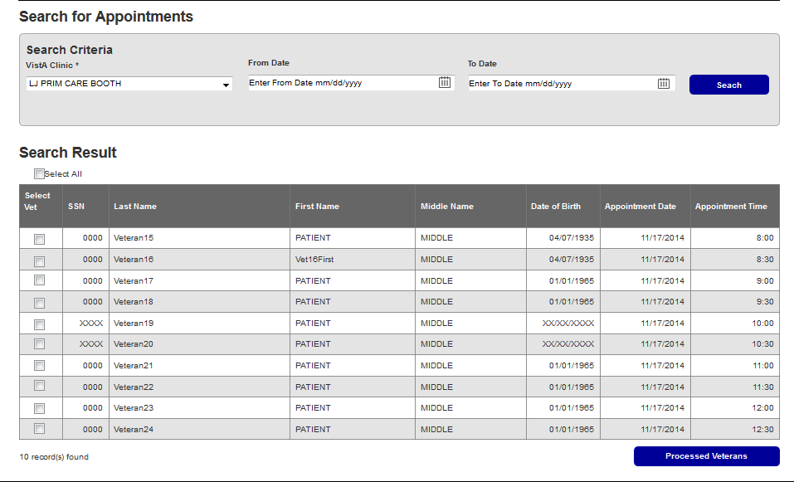

3 | Setting up single or batch Assessments
A. Selecting Veteran
Select the check boxes by the Veterans that you want to include.
Click Select Veterans.

Slide 19
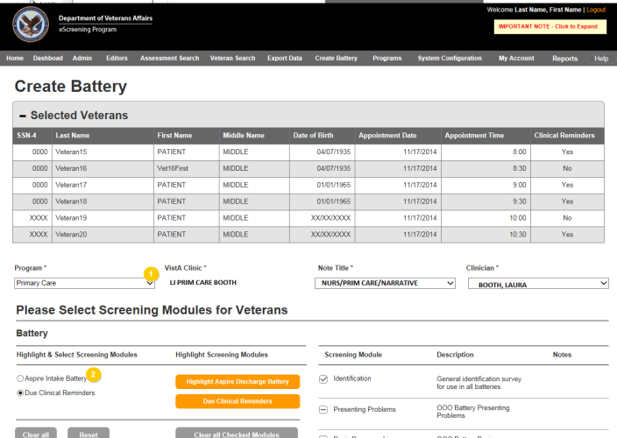
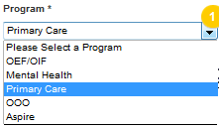
3 | Setting up Assessments
B. Selecting settings and Clinical Reminders
Select the program, clinic, note title, and clinician from the drop-down lists.
Select Due Clinical Reminders (see list on the next slide).

Slide 20
3|Setting Up the Assessment
Clinical Reminders
Clinical Reminders available in eScreening
Homelessness Screening
Advanced Directive Screen
Screen for Infectious Disease and Infectious Fragments, 4A-4D (Iraq & Afghan Post-Deployment Screen)
Tobacco Cessation Screen
Alcohol Use Screen (AUDIT-C)
TBI Screening
Depression Screening
MST Screening
Screen for PTSD (PC-PTSD)
Pain Scale: 0-10 (Vital, not clinical reminder)

Slide 21
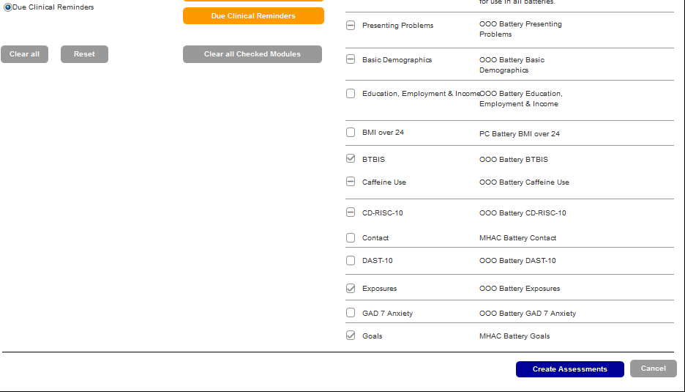
3 | Setting Up the Assessment
B. Creating the Assessment
3. Scroll to the bottom of the page, then click Create Assessments.

Slide 22
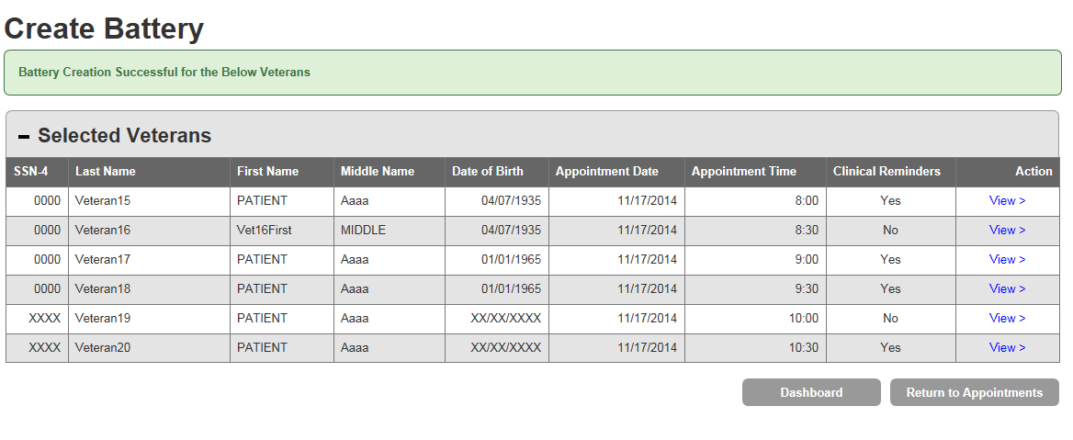
3 | Setting Up Assessments
B. Confirmation
A banner confirms the Battery was created.
The system is ready to accept input from the Veterans you created Batteries for.
The next slide displays the Veteran log in screen.

Slide 23
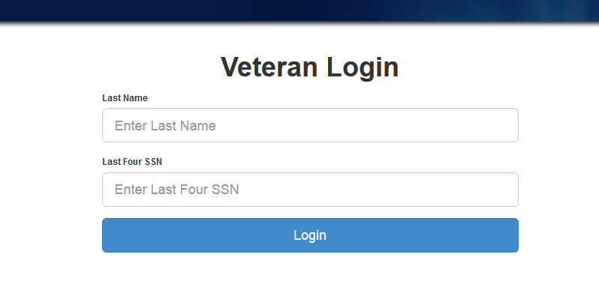
3 | Setting Up a Battery of Screens
B. Assigning a New Battery to a Veteran
The Veteran sees this screen on the tablet.

Slide 24

Training Modules
Today’s Training Covers:
Overview 5 minutes
Setting Up an Assessment 4 minutes
Reporting and Data 1 minute
Troubleshooting & Additional Support 1 minute
User Roles, Permissions, & Security 2 minutes
Dashboard Features 6 minutes
1
2
3
4
5
6

Slide 25
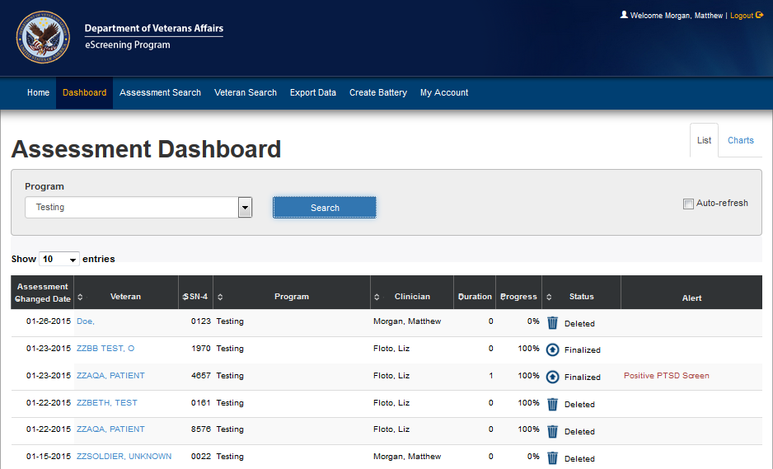
4 | Dashboard Features
From the Home screen, click Dashboard.
The Dashboard opens in List view. This view shows Veterans with a battery scheduled, in progress, or completed, and any alerts associated with the screenings.

Slide 26
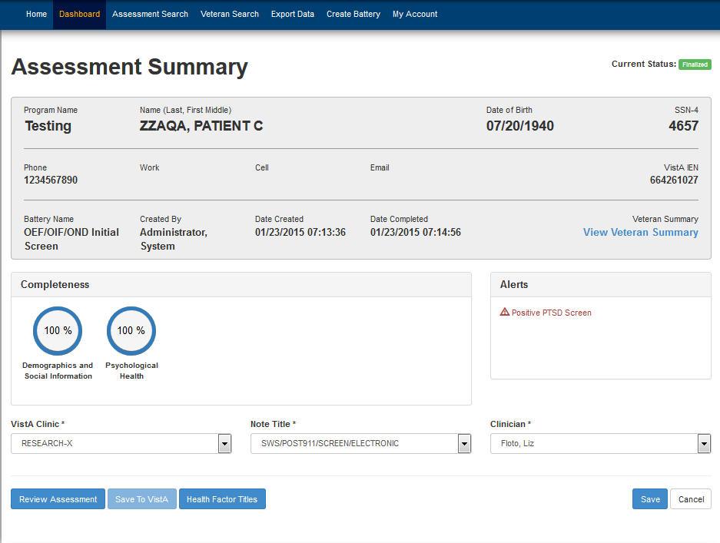
4 | Dashboard Features
Clicking a Veteran’s name brings you to the Assessment Summary page:

Slide 27
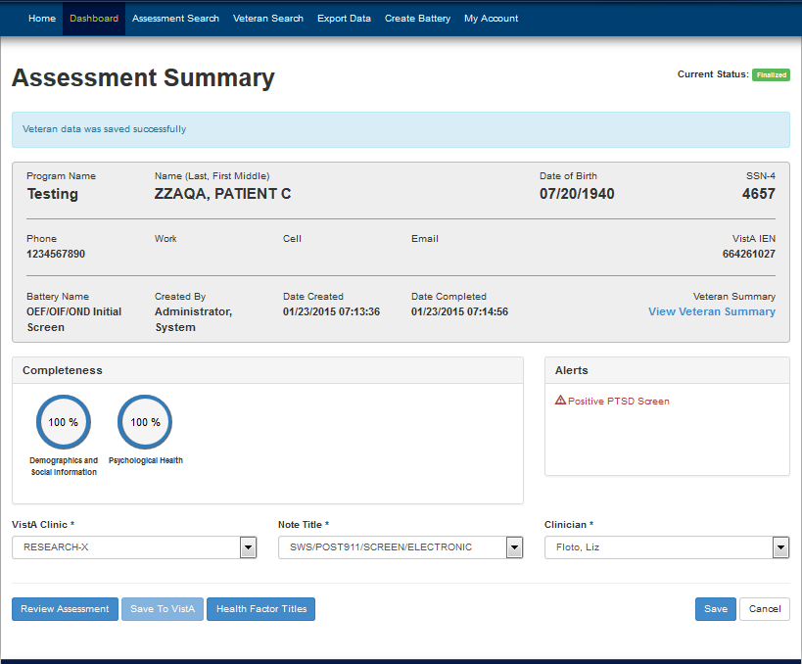
4 | Dashboard Features
The Assessment Summary has many functions:
Review CPRS Note
View & Print the Veteran Summary
Save to VistA

Slide 28

Training Modules
Today’s Training Covers:
Overview 5 minutes
Setting Up an Assessment 4 minutes
Reporting and Data 1 minute
Troubleshooting & Additional Support 1 minute
User Roles, Permissions, & Security 2 minutes
Dashboard Features 6 minutes
1
2
3
4
5
6

Slide 29
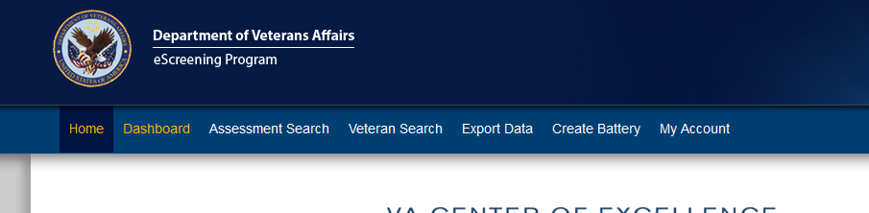
5| Reporting and Data
Introduction to Reporting and Data
MHE incorporates functions that allow you to view Veteran and assessment data, and generate various reports.
You can:
search the System for past Veterans and Assessments.
print or review a Veteran’s individual questions and answers.
export data for program evaluation.

Slide 30

Training Modules
Today’s Training Covers:
Overview 5 minutes
Setting Up an Assessment 4 minutes
Reporting and Data 1 minute
Troubleshooting & Additional Support 1 minute
User Roles, Permissions, & Security 2 minutes
Dashboard Features 6 minutes
1
2
3
4
5
6

Slide 31
6| Troubleshooting & Support
Additional Training
Supplemental and future trainings options:
Future refresher training, as needed
Review the User Training Manual
Contact your training points of contact:
Liz Floto
858-552-8585 Ext. 5550
Elizabeth.floto@va.gov
Matthew Morgan 858-552-8585 ext.5557
Matthew.Morgan@va.gov

Slide 32
eScreening Policies and Procedures for Primary Care
Inclusion and Exclusion Criteria
Include:
All capable Veterans who present to Primary Care to see a Primary Care provider who is taking part in the pilot.
Exclude:
Veterans whose CPRS record carries a SAIL flag. Veterans who have been SAIL flagged present a danger due to aggressive behavior and could use the tablet as an instrument to harm others.

Slide 33
eScreening Policies and Procedures for Primary Care
Guidelines and Restrictions
1. eScreening should precede all Primary Care appointments which fall on Tuesday through Friday, after 9am.
2. An RN (or MSA) belonging to each pilot provider’s PACT should attempt to create assessments for all appointments scheduled on the following day. Creation should occur daily at 4:30PM or just before COB.
3. Veterans must arrive at least 10 minutes prior to the scheduled appointment time in order to receive a tablet for eScreening.
4. Veterans with CPRS records containing a SAIL flag must never be given an eScreening Tablet.
5. Some veterans may be physically unable to use the eScreening tablet. Use your best judgment.

Slide 34
eScreening Policies and Procedures for Primary Care
Exemptions to eScreening:
Inevitably, there will be some cases in which a veteran is unable to, or refuses to, take part in eScreening. These situations may include Veterans with impairments such as diminished vision, amputation, traumatic brain injury, drug or alcohol detoxification (delirium tremens), and other problems.
If a veteran refuses to accept an eScreening tablet, or is otherwise unable to do so, then nurses and healthcare providers should conduct clinical reminder collection by standard protocol.

Slide 35
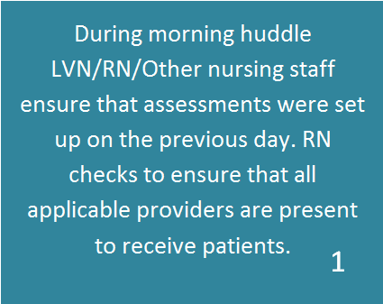
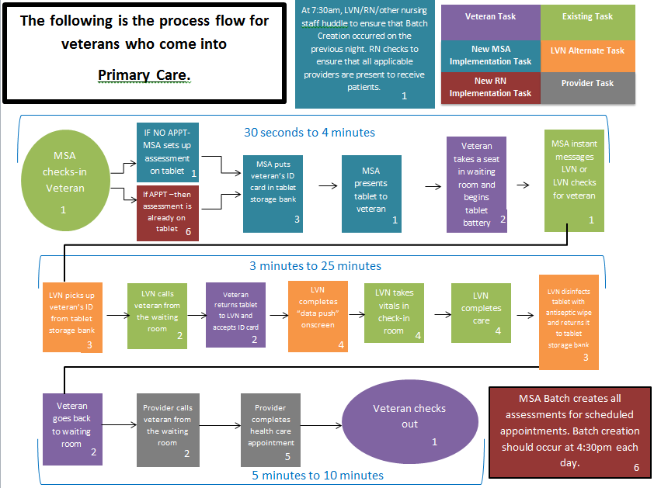
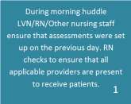



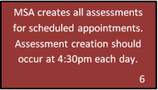
Primary Care Management Work Flow

Slide 36

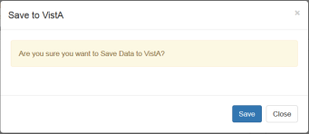

Using CPRS with eScreening
Saving eScreening Data to VistA
Click Dashboard → Select Veteran.
Click Save to Vista, then click Save. Veteran data is saved to VistA.

Slide 37
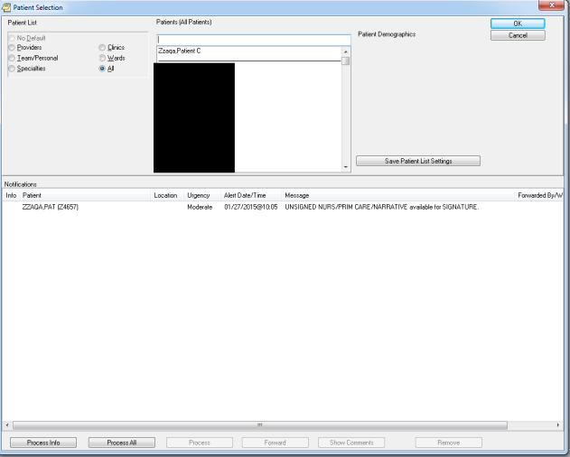
Using CPRS with eScreening
Alerting
After the information is saved to CPRS/VistA, a notification is generated.

Slide 38
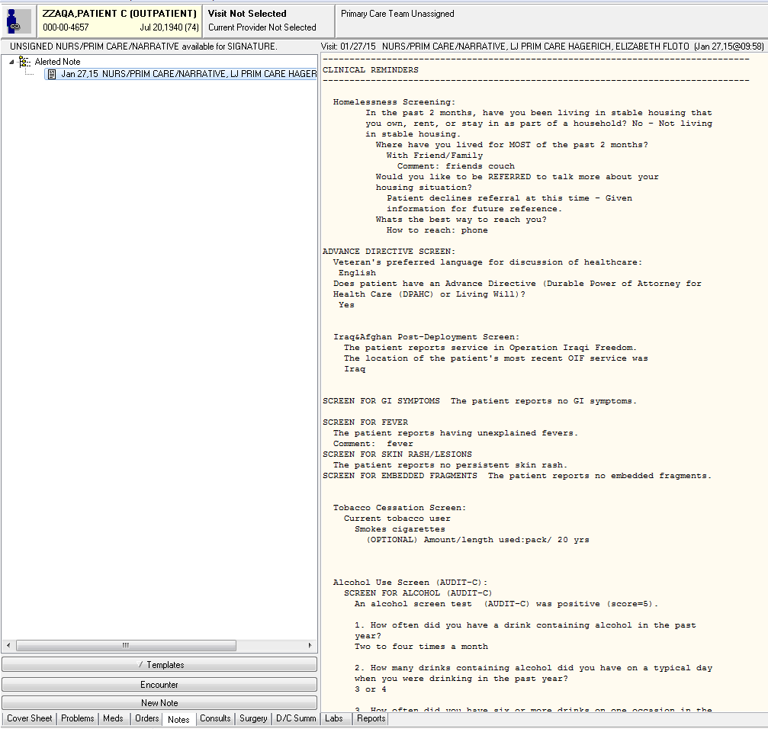
Using CPRS with eScreening
CPRS Note
eScreening will begin your note and auto-populate the information the Veteran entered on the Tablet—including Clinical Reminders.

Slide 39
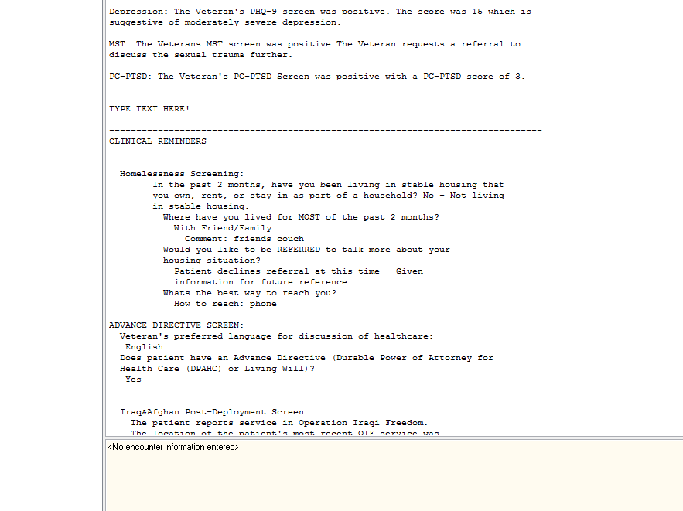
Using CPRS with eScreening
Editing the Note
Click Edit Note to add additional information to the note.

Slide 40
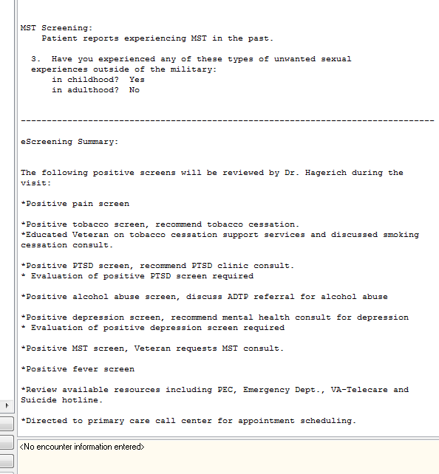
Using CPRS with eScreening
Footer
Any positive screens will be summarized in the bottom of the note for the Provider to attend to during the visit. You can add the Provider as a Cosigner as necessary.

Slide 41

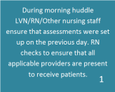



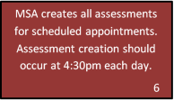
Primary Care Management Work Flow

Slide 42
Practice Assessment creation in the system here:
https://vaww.escreening.va.gov/sd/
Click STAFF ACCESS.
Username: VHASDC******
Password: Password#1

Slide 43
Questions?

Slide 44
Thank you for attending the training!

